Slide 1
CityPulse —
Smart City Information Dashboard
GROUP 9
S24MCAG0030 AHANA KAUR
S24MCAG0019 ANUSHKA GARG
S24MCAG0051 SONALI SINGH

Slide 2

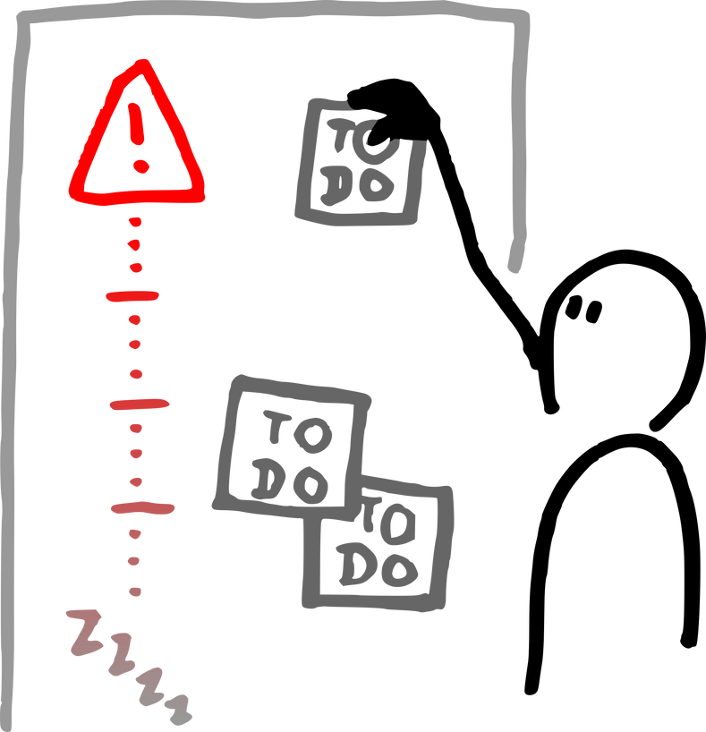

Introduction
GROUP 9
Project Objective
To design and develop an interactive, client-side smart city dashboard using only HTML, CSS, and JavaScript
The goal was to simulate a modern urban data portal, focusing on usability, interactivity, and clear data presentation.
A key requirement was to achieve full functionality—including data display, filtering, and popups—without using any backend database or server.
2

Slide 3

Introduction
group 9
Technical Stack & Constraints
Technologies:
  HTML5: For semantic structure.
  CSS3: For styling, layout (Flexbox/Grid), and animations.
  JavaScript (ES6+): For all interactivity and DOM manipulation.
Key Constraints:
  100% Client-Side: All data (alerts, weather, map zones) is stored in static JavaScript objects and arrays within the HTML file.
  No alert() / confirm(): All notifications and popups are custom-built HTML/CSS overlays, a core requirement of the project.
  Static Deployment: Designed to be deployed on any static host, like GitHub Pages
3

Slide 4
Application Features Overview
group 9
Application Features Overview
Key Insight
The application is a Single Page Application (SPA) framework, simulated using JavaScript to dynamically show and hide four main views:
1
2
3
4
Home Dashboard: At-a-glance city overview and key metrics.
City Alerts: A filterable and sortable list of civic news
Interactive Map: Clickable city zones with details-on-demand.
Citizen Connect: A feedback form with custom client-side validation.
4

Slide 5
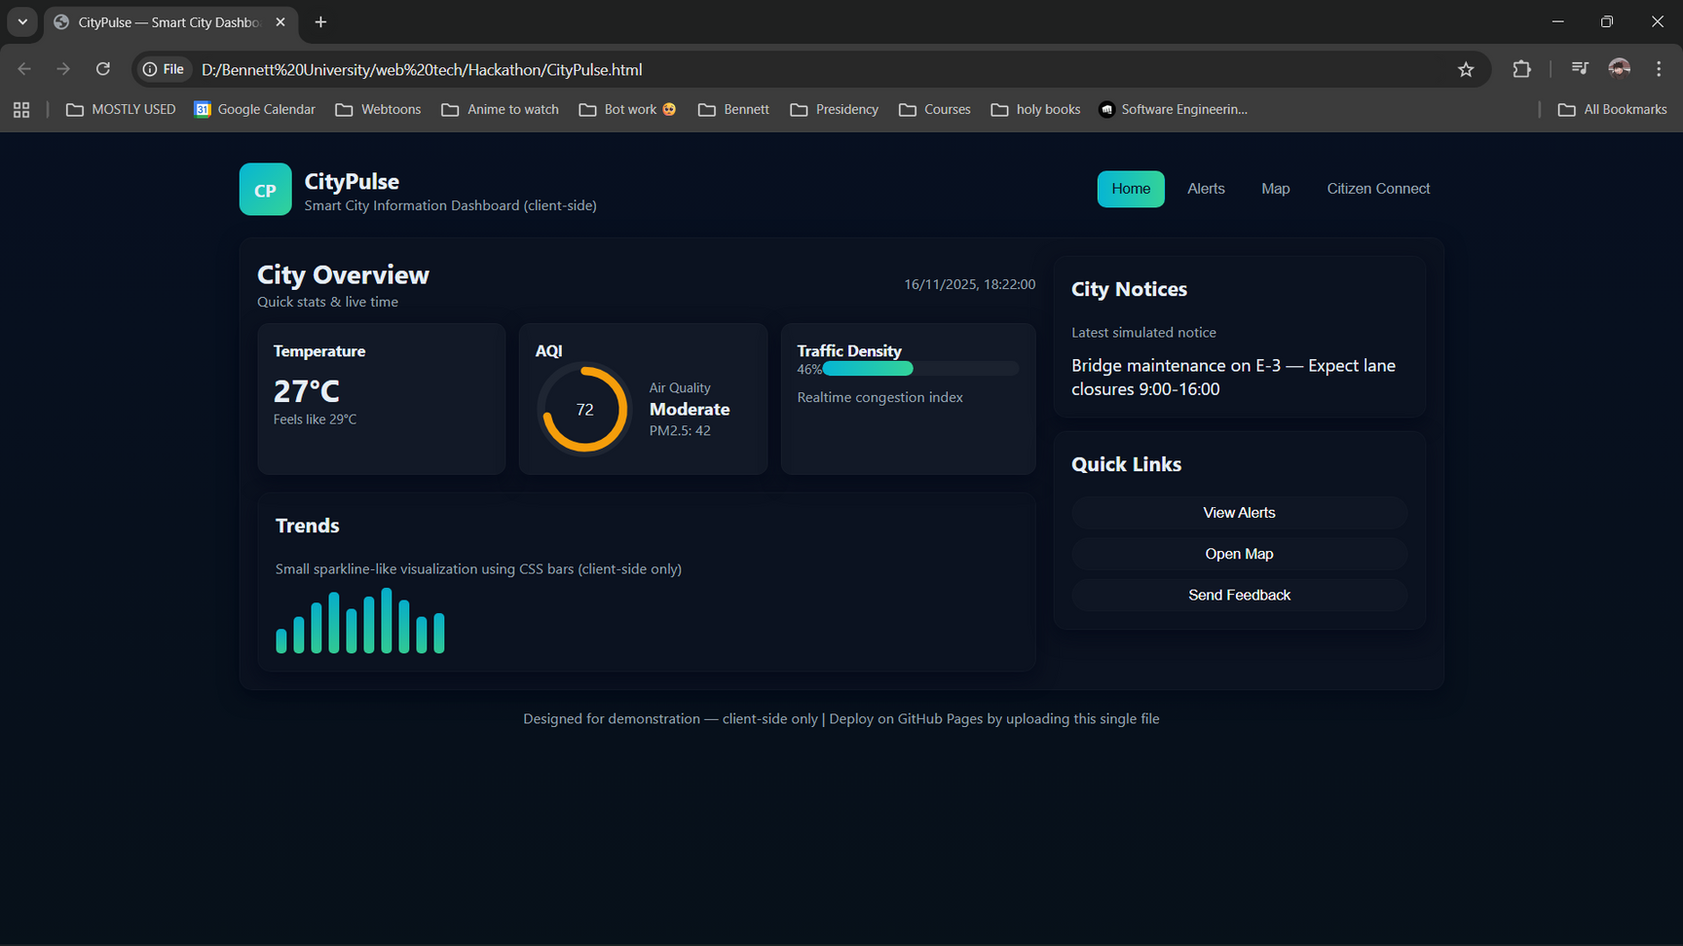

Feature Deep Dive (1/4): Home Dashboard
group 9
Feature: Home Dashboard
Displays summarized city data from the CITY JavaScript object.
Key Components:
Visual:
  Live Data Widgets: Temperature, "Feels Like," and a live-updating clock.
  Dynamic AQI: An SVG arc that dynamically changes its length and color based on the AQI value.
  Traffic Density: A CSS-driven progress bar.
  Data Trends: A simple bar chart rendered using CSS.
5

Slide 6
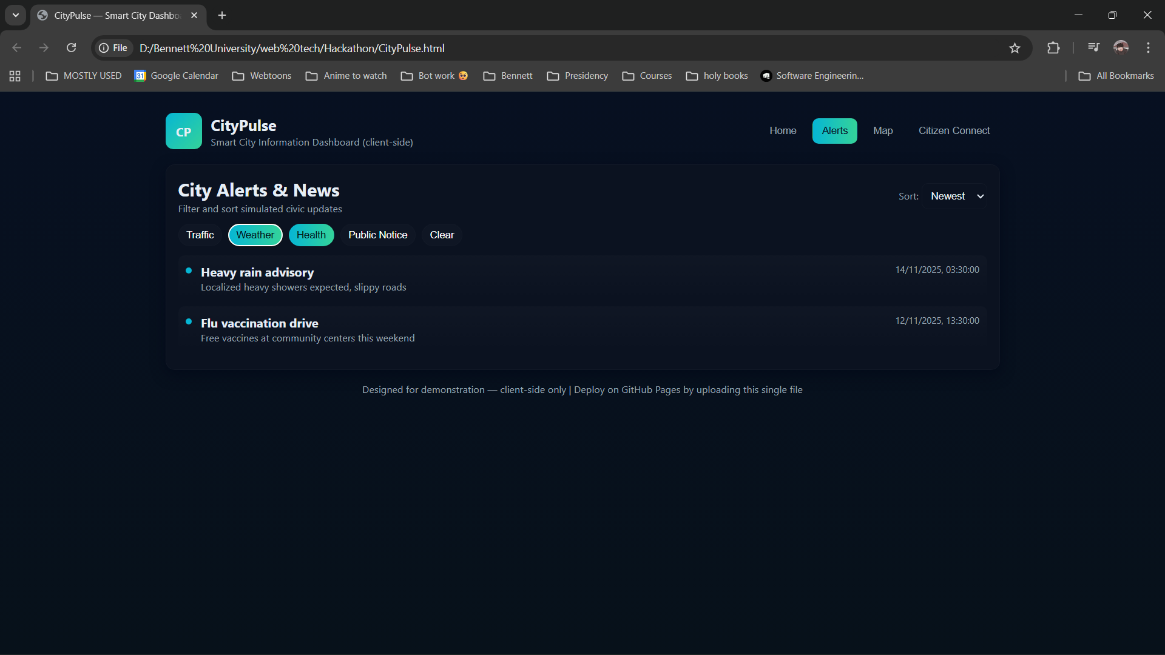
Feature Deep Dive (2/4): City Alerts & News
group 9
Feature: City Alerts & News
Dynamically renders a list of alerts from the ALERTS JavaScript array.
Custom Modal: Clicking any alert opens a custom-built modal with more details, fulfilling the "no alert()" constraint.
Dynamic Filtering: Users can select "chips" (e.g., Traffic, Weather) to filter alerts by type.
Sorting: A dropdown menu allows sorting by Newest, Oldest, or Type.
VISUAL:
6

Slide 7
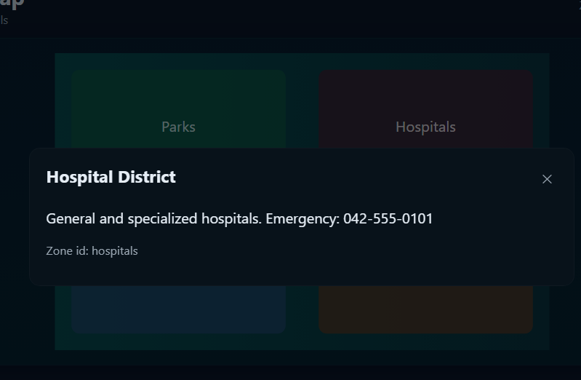
Feature Deep Dive (3/4): Interactive Map
group 9
Feature: Interactive Map
Features an SVG map with clickable zones defined in the HTML.
Key Features
Hover Effects:
Clickable Zones:
Zones highlight on mouse-over using CSS and JavaScript event listeners.
Each zone (Parks, Hospitals, etc.) is clickable.
Modal Popups:
Clicking a zone opens the custom modal to display specific information loaded from the ZONES JavaScript object.
7

Slide 8
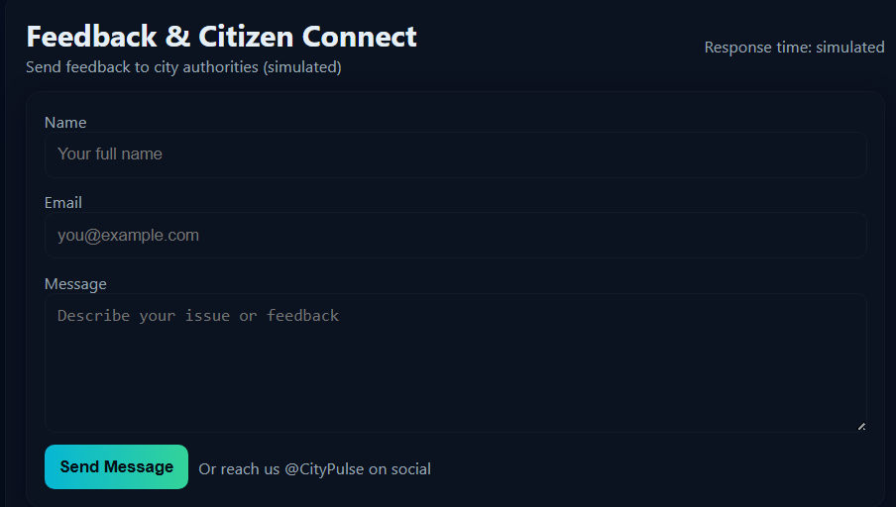
Feature Deep Dive (4/4): Citizen Connect
group 9
Feature: Citizen Connect
A fully functional contact form for user feedback.
Key Functionality
  Client-Side Validation: The form is validated in-browser using JavaScript.
  Custom Error Messages: Checks for name length, valid email format (using RegEx), and message length. Error messages are displayed dynamically in the DOM.
  Success Modal: On successful submission, a custom modal appears to confirm the (simulated) submission.
8

Slide 9
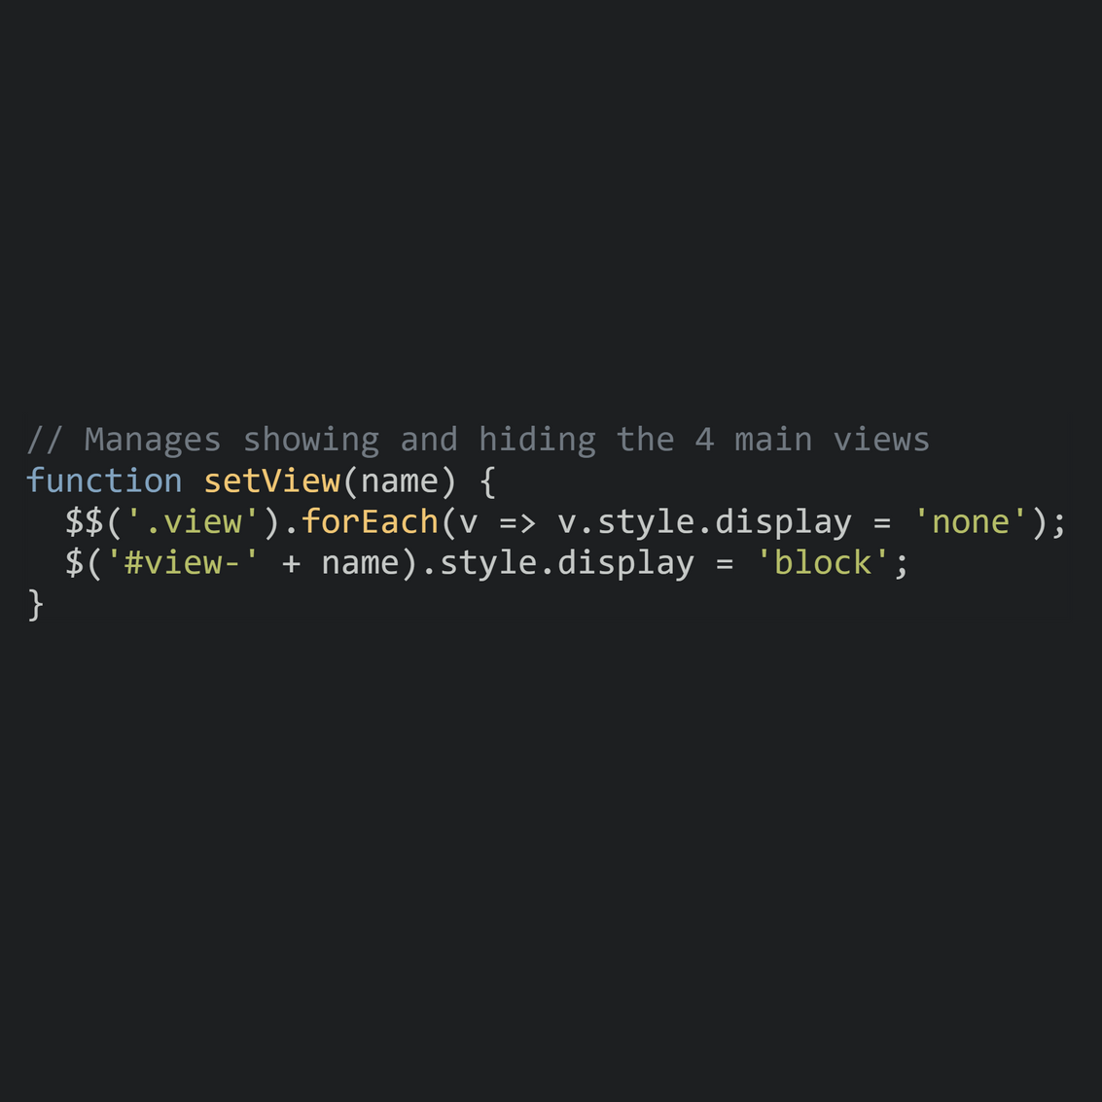
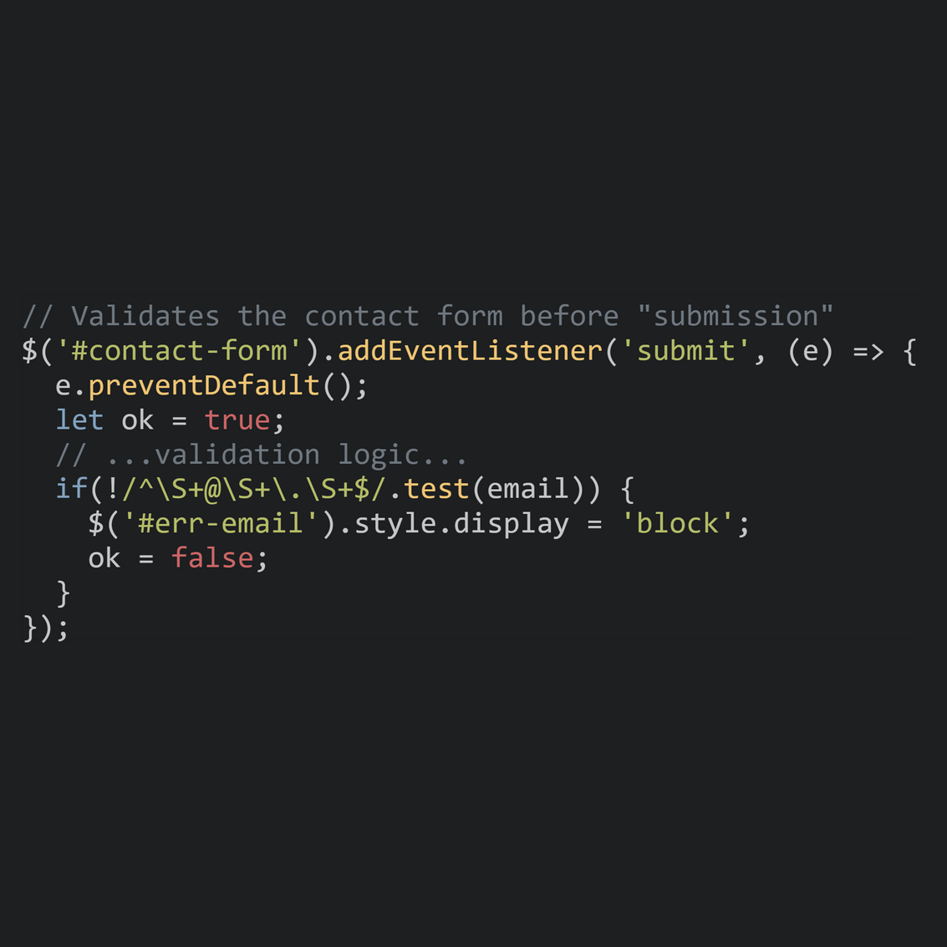
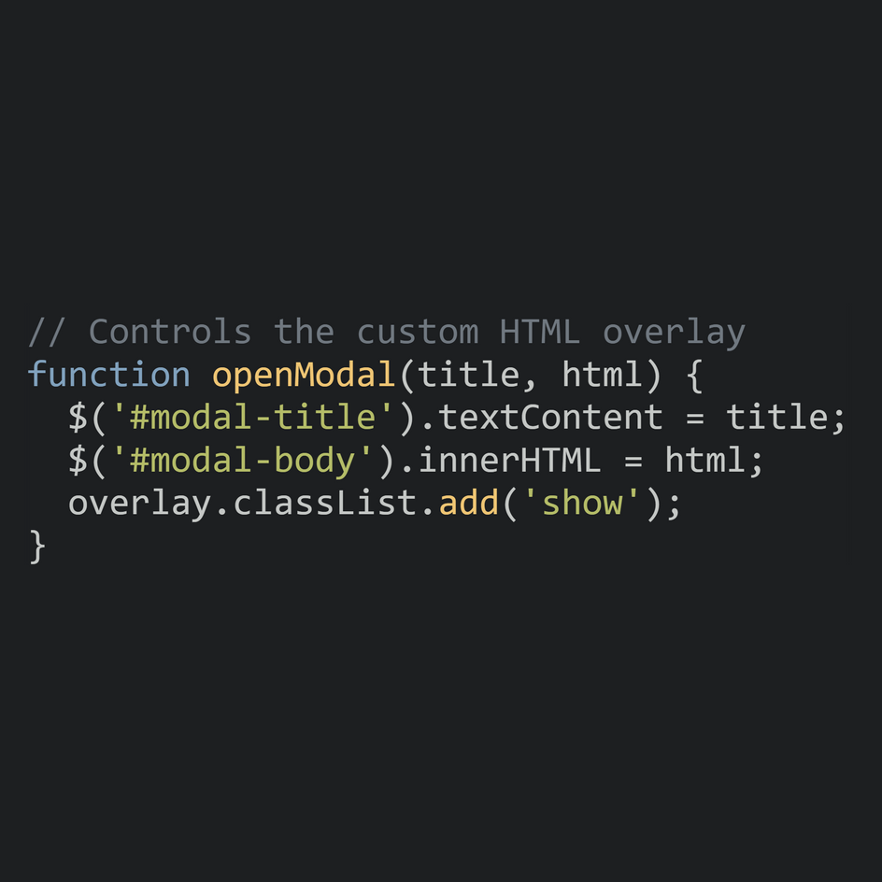
Code Highlights
group 9
Code Highlights: How It Works
A look at the JavaScript functions that power the dashboard.
View Switching (SPA Simulation):
Dynamic Form Validation:
Custom Modal Logic (No alert()):
9

Slide 10
Conclusion
group 9
Conclusion
Project Status:
Key Achievements:
Complete. The CityPulse.html file successfully meets all objectives and technical constraints outlined in the project description.
  Built a highly interactive, data-driven dashboard using only vanilla JavaScript.
  Successfully simulated a full-stack application's user interface.
  Implemented all interactivity, including filters, sorting, and modals, without external libraries or a backend.
10

Slide 11
The End
GROUP 9
S24MCAG0030 AHANA KAUR
S24MCAG0019 ANUSHKA GARG
S24MCAG0051 SONALI SINGH

